Slide 1
College Credit Plus
Information Session for 2021-2022 Participation
---
CCP Program Information

Slide 2


What is College Credit Plus?
Dual enrollment opportunity for eligible students in grades 7-12
Earn high school and college credit concurrently
Promotes college & career readiness
Highly transferable courses
Accessible course offerings
  High School (if available), Edison State campuses, Online
Courses can satisfy HS graduation requirements
Notes:
College Credit Plus is a State program where students earn both high school and college credit concurrently. Although tuition is free for the student, there may be some instances where there may be a small fee. College Credit Plus promotes college and career readiness, and most courses are transferable to other colleges and universities nationally, and courses can satisfy high school graduation requirements as well.

Slide 3

What is the cost to participate?
Participation is FREE for public school students
  No application fee
  Free assessment
  Tuition and textbooks are included
Consumable supplies purchased by students
Financial risk for failed or withdrawn courses
Nonpublic & homeschool students must apply for state funding
  Must apply for funding annually. Credit hour award may vary each year.
  Additional details at www.ohiohighered.org/ccp/students-families
Notes:
There is no cost to the student; no application fee, the first placement assessment is free, tuition costs are covered in most cases and textbooks are covered as well. There are slightly different parameters for nonpublic and homeschool students. Consumable supplies such as paper, pencils, etc, are purchased by the student, and there are some financial risks if a student withdraws from a class or fails a class.

Slide 4
How many/what type of courses can I take?
Eligible students may take up to 30 credits per academic year (summer, fall, spring) - (120 program max)
  Dependent on number of non-CCP courses taken at the HS
  Self-pay option for courses exceeding 30 hours
    billed by Edison State at current standard tuition rate.
“First 15 Rule” – established 18/19
  Must complete 15 credit hours in Level I before progressing to Level II
Course Exclusions:
  Remedial, private instruction, physical education, etc.
Notes:
State guidelines dictate how many credit hours a student can participate in each year. Students who are eligible may be able to take up to 30 credit hours in an academic year. This is dependent up on the number of non-ccp courses being taken at the high school. Your guidance counselors can help you calculate those hours. Student who exceed 30 credit hours may pay out of pocket for the course that caused the overage. Edison State will bill the student for the course at the standard tuition rate for any ccp course exceeding the state limit or for level II courses taken before meeting the “first 15” criteria
The academic year for CCP starts with the Summer semester.
Under the First 15 rule, students must complete 15 credit hours in Level 1 courses prior to progressing to Level II courses. All Level II courses are posted on Edison State’s CCP website.
Courses not covered by CCP are remedial, private instruction such as piano lesson, and PE, to name a few.

Slide 5
How are grades/credits posted?
Grades are recorded on the student’s high school and college transcripts
College courses (3, 4, 5 credit hours) = 1 Carnegie unit
Failing or Withdrawing
  State guidelines for underperforming students – Probation/Dismissal policies
  Financial Responsibility – reimbursement to high school
Lasting Impacts
  Permanent college record
  Impacts high school & college GPA
  Athletic eligibility
  Financial Aid eligibility
Notes:
The grades students earn in College Credit Plus courses are posted on both their high school and college transcript. College courses of 3 credit hours or more, equal 1 Carnegie unit – meaning that a semester-long course at the college equals one full-year course for the high school.
Students who fail or withdraw from CCP courses may face consequences such as CCP probation/dismissal procedures, which limit or prohibit enrollment for following semesters. Additionally, students who fail or withdraw from CCP courses become financially responsible for the costs of the college course and may be required to reimburse the school district for the costs associated with the course.
Students should keep in mind that the grades earned in College Credit Plus courses are recorded on their permanent college transcript. Grades earned during participation will impact both their high school and college GPA which could impact athletic eligibility at the high school and financial aid eligibility after high school.

Slide 6

Are there any other factors to consider?
Things to consider:
  Course content & format
  Accelerated pace
  Self-discipline
  Emotional & social transition
  Diverse student demographics
  End of course exams
  Extracurricular activities & athletic eligibility
FERPA & Parental Role
Communication expectations
  Students & parents
  Students & guidance counselor
  Students & college staff/faculty
Notes:
Here are a few other things to consider when paraticipating in College Credit Plus.
Testing college-ready does not always mean a student is “ready” for college.
There are other things to consider, such as course content and format, the pace of the class, self-discipline (especially for online classes), Emotional and social demographics, end of course exams, extracurricular activities, and athletic eligibility.
FERPA – educational rights transition to the student upon enrolling in an institution of higher education. This transfer of rights occurs regardless of the student’s age. Having a FERPA waiver (part of application) on file provides parents with access to limited information about their student’s records. However, it is still recommended that the student takes on the responsibility of initiating communication with the college. Parents are always welcome to attend advising appointments along with their student.

Slide 7

What happens after high school?
Students continuing at Edison State…
Meet with a Pathways Advisor to register for semester after high school
Scholarship Opportunities
  CCP Scholarship - Up to 100% off tuition!
    www.edisonohio.edu/ccp-scholarships
  Edison State Scholarship Application
    www.edisonohio.edu/scholarshipapps
Students transferring to another institution…
Transfer credits by submitting official college transcript
  Transcript request online through MyESCC

Slide 8




How to get started at Edison State?
Submit Letter of Intent to high school
  April 1st – Deadline for 2021-2022 participation
  COVID flexibility – deadline extended to May 1st
Complete Edison State’s CCP admission process at www.edisonohio.edu/ccp
Recommended completion (application & assessment)
  May 1 – summer & fall registration
  November 1 – spring registration
Notes:
The Letter of Intent is a document provided by the student’s high school. The student’s signature is required and it is due to high school by April 1st. The letter of intent does not lock a student into participating in CCP, but it may hinder student from participating if not submitted.
Qualifying for CCP as ESCC is as easy as 1, 2, 3. Apply, Assess, Orientation. More information can be found online at www.edisonohio.edu/ccp
We recommend that students who want to start participation in CCP in summer or fall, should complete their application and assessment prior to May 1, and Novermber 1 for Spring start date.

Slide 9

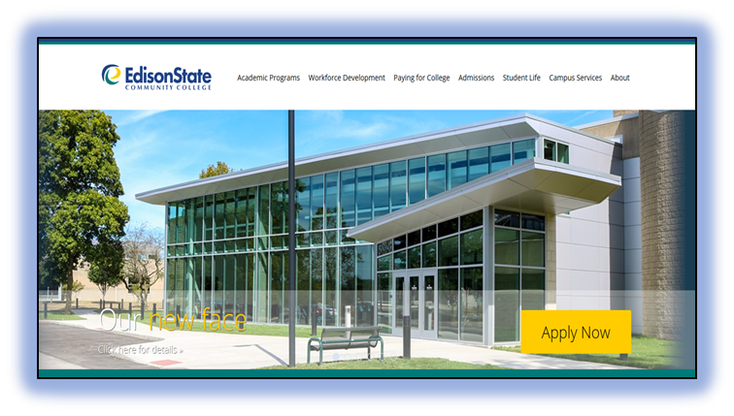
Online Application
www.edisonohio.edu/ccp
Edison State admission
Generates student account & ESCC ID number
Application MUST be completed prior to assessment process
Notes:
Lets talk about how to apply. The online application can be conveniently accessed from any of the yellow “Apply Now” buttons on Edison State’s website. Your application MUST be submitted two weeks prior to your assessment appointment. When you apply to Edison State, your student ID number is generated. This number will be needed when you take the Accuplacer Assessment, so be sure to apply early.

Slide 10
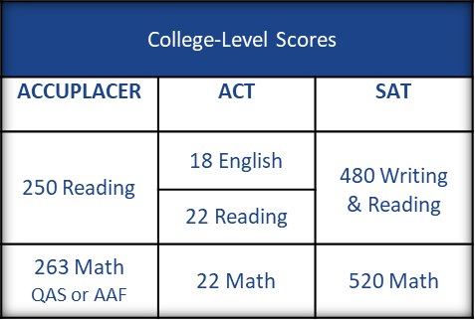
Qualification Process - Assessment
In order to participate in the CCP program,
students must meet specific program and course eligibility criteria.
Program Eligibility
  Statewide standards for participation
  College-level assessment scores – ACT, SAT, Accuplacer, etc.
  COVID Flexibility – 3.0 cumulative HS GPA
Assessment Process for 2021-2022 participation
  Request counselor to submit transcript for review to Edison State liaison, craterman@edisonohio.edu
Course Eligibility
  Course Prerequisites
  Multiple Measures
Notes:
The state sets the minimum eligibility standards for participation.
Program eligibility and course eligibility is outlined on the student’s ACCUPLACER score report, which is emailed after the assessment is completed. It is important that students sign into the testing platform with a valid email address.
See testing insert and website for available testing times. Registration occurs online.

Slide 11


Selecting Courses
Students are encouraged to select courses based on…
  Career Pathway/Long-term goals
  HS graduation requirements
  Skill development or interest
Students may take classes in any available format
  High School – if available
  Edison State campus
  Online – must demonstrate online readiness
View courses options online through MyESCC
Prerequisite course work must be met
  Example: ENG 121 before ENG 122
  Assessment score prerequisites
Notes:
Student may take classes in any “available” format. Some partnering school districts offer courses within their HS. Courses are also available on campus or online. Students who wish to take an online class for the first time at Edison State, must complete the Online Readiness Workshop prior to the start of the term.
The course schedule is available in WebAdvisor for a limited time, or in MyESCC.
All prerequisite work must be met.
Advisors are available to help students define their academic goals and create an academic plan. Call the campus to schedule an advising appointment.

Slide 12


Course Registration
Registration occurs each semester
  Summer, Fall, Spring
Courses offered on campus or online
  CCP Registration Form
    All changes require GC authorization
    Add, Delete, Drop, Withdraw
    Must be submitted to Edison State prior to each term
    Registration timeline, waitlists, HS registration dates
Courses offered at partnering high schools
  Registration Form OR Batch Registration/Rosters
Notes:
Registration occurs each semester. Some partnering HS’s will use utilizing a “batch” registration process for registering students for courses offered within the HS. This information will be communicated to the students at the HS. All online and on campus courses must be registered for by using the registration form.
All schedule changes must be authorized by the high school guidance counselor and submitted to Edison State via a signed Drop/Add Registration form.
Adding -
Deleting -
Dropping -
Withdrawing -
Registration Forms and Big Date can be found online at www.edisonohio.edu/ccp

Slide 13

Online Student Orientation
Online orientation for all new CCP students
  Offered through Blackboard – virtual classroom
  Log-in credentials available after student’s first course registration
  Learn about Edison State resources, services, and online tools
  NEW – online orientation now includes the “online workshop”
    Learn to navigate online classroom, success skills, and more!
    Must be completed prior to start of online coursework

Slide 14
Additional Information
PDF of Steps & Career Pathway Information
PDF of Classes at New Bremen

Slide 15

Thank You!
Learn more about College Credit Plus at Edison State at www.edisonohio.edu/ccp
Questions?
Contact Christina Raterman at craterman@edisonohio.edu

